Slide 1
WHAT IS PUBLISHING?
GROUP 1

Slide 2
How do we provide the greatest benefit of the scholarly enterprise to a global society in a sustainable way?

Slide 3
What can publishing become?
We’ve been talking about this for a long time….
“A day will come when journals will be superseded as a means of publishing new research.”
— Theodore “Robbie” Fox (1965), Editor of The Lancet 1944-1964
Notes:
We are making an operating assumption here that “publishing” (writ large) needs transformational change. But our reasons for the change are not the same for everyone (across stakeholder groups). Several groups talked about a greater need for collaboration and communication.

Slide 4
DEFINING THE PROBLEM
Our notion of “publishing” was concrete, mechanistic, and monolithic -- a shared infrastructure with definitive boundaries.
This paradigm is still in operation; it has been disrupted by the web, not transformed.
Academic publishing models are largely the same as 30 (or even 350) years ago. Are we okay with this pace?
Notes:
We have applied innovation in certain areas but not all of them and we still have much of the status quo remaining. Tinkering with what is rather than pulling the rug out.

Slide 5
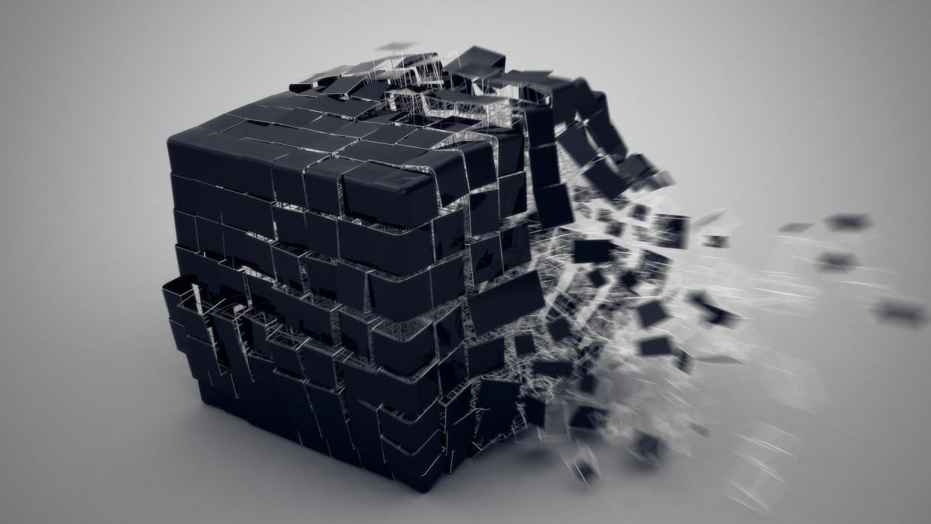
Notes:
Our group was operating under the assumption that we are not satisfied with the pace. What we need is real transformational change to the paradigm in a way that is practical and sustainable.

Slide 6
WHAT IS PUBLISHING?
... a process that creates/captures and makes discoverable artifacts of knowledge in order to facilitate the use and reuse of scholarship on a global scale. It enables research communities to build upon the work of others and provides a venue for evolving discourse.
Notes:
Here is the (somewhat aspirational) definition of publishing that we adopted for the purposes of our group’s work here.
Not just a journal article or monograph, but also blogs, multimedia, data, visualizations. And maybe not permanent - could be changing or even purposely ephemeral - where citation to the work requires date stamping, etc. So extends well beyond the reach of traditional publishing and also may not require the same suite of publishing services. Do you copy -edit a database?

Slide 7
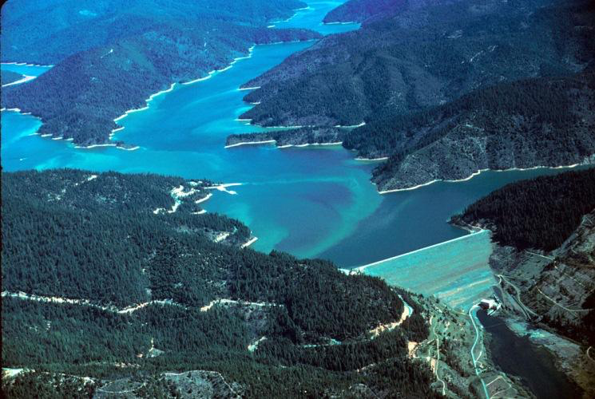
Tributary of
Information
Tributary of Information
Tributary of Information
Body of Information
Dam(n)
Notes:
We tend to think about things we don’t really understand as black boxes, but when we started drilling down into publishing, we realized a better metaphor might be a dam. We know it has worked in the past, but we don’t know how necessarily. Nontransparent monolithic gatekeeping function that occurs at a specific point in the research process. And as we start to think about different ways we might harness the power of this flow of information and knowledge, we thought about how difficult it could be to dismantle this existing structure. The only images we found for deconstructing dams involved blowing them up entirely. So no wonder there is resistance to that.

Slide 8
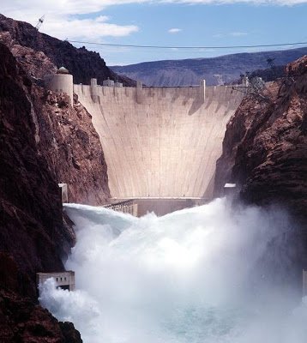
OBSTACLES
Infrastructure Limitations
Authorship, Attribution, Credit
Standards & Rewards:
Hiring, Promotion
Business Models
Publishing:
Pace of Information Processing and
Peer Review
Notes:
These are both the obstacles and the existing power structures that are holding us back from transformative flow of knowledge outward.

Slide 9
WHAT IS THE MISSION?
For everyone who needs access to scholarly information to have it;
For authors to have choices that they don’t currently have;
To encourage disruption in business models by unbundling the research process and opening up new services around it;
To encourage entry of new individuals and organizations into the knowledge ecosystem.
Notes:
We have applied innovation in certain areas but not all of them and we still have much of the status quo remaining. Tinkering with what is rather than pulling the rug out.

Slide 10
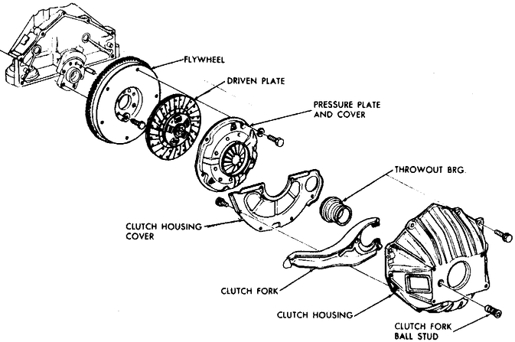
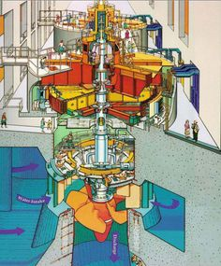
Can we ‘UNBUNDLE’ publishing?
Single stable artifact (journal article or monograph) ---> multiple research objects
Monolithic (one-size-fits-all) black box ---> a menu of unbundled service offerings
Notes:
We have applied innovation in certain areas but not all of them and we still have much of the status quo remaining. Tinkering with what is rather than pulling the rug out. Moving away from publishing of a single “artifact” of a stable paper as the end product of research - to include data, amendments, protocols, blogs, music files. etc. And by unbundled services offerings we think of things like authoring, peer review, copy editing, production, preservation, dissemination. Here authors could have more choice about what services if any they (or their institutions) need to purchase for a particular research object they want to publish. So if you are adding additional research information to something that already exists, what kind of peer review do you need?

Slide 11
CALL TO ACTION - NEXT STEPS
Within our context of publishing as an interdependent ecosystem...
Audit what exists for and evaluate each module of an unbundled publishing ‘service’
Form a working group on open source, standardized, federated, modular infrastructures
e.g. VIVO published works ontology, CrossRef, ORCID, Collaborative Knowledge Foundation, Ambra
Notes:
We have applied innovation in certain areas but not all of them and we still have much of the status quo remaining. Tinkering with what is rather than pulling the rug out. v1: Evaluate best in-class examples of distinct publishing services that can be considered variables in a test of a new, shared, standards-based infrastructure that serves an author-focused system and incentivizes and serves global scholarship and innovation.

Slide 12
How do we provide the greatest benefit of the scholarly enterprise to a global society in a sustainable way?
What is publishing? -> What will publishing be?
Notes:
When we ended our discussions we agreed that we needed data to determine whether any changes we experiment with in publishing actually IMPROVES is - where improvement is measured by this framing question, of making the scholarly enterprise of greatest benefit to global society in a sustainable way, and to think like systems engineers on the effect of changing individual components on the function of the entire system to benefit global society.

Slide 13
OUR TEAM
Amy Brand, Director, The MIT Press
James Butcher, Publishing Director, Nature Journals
Meg Buzzi, Director, Opus Program, UCLA
Kathleen Fitzpatrick, Director of Scholarly Communication, Modern Language Association (MLA)
Ann Gabriel, Vice President, Academic & Research Relations, Elsevier
Rikk Mulligan, Program Officer for Scholarly Communication, Association of Research Libraries (ARL)
Vivian Siegel, Director of Education and Training, Global Biological Standards Institute
Matt Spitzer, Community Manager, Center for Open Science (COS)
Jamie Vernon, Director of Science Communications and Publications at Sigma Xi and Editor-in-Chief, American Scientist
Supporting notes: https://docs.google.com/document/d/1ChYsQ9RxcSTuYv1PqLFnDXX3z0PjnrnI0EUWkP-QXCs/edit?usp=sharing

