Slide 1
OSI 2016: Peer Review

Slide 2
Peer review is the worst form of evaluation
except all those other forms that have been tried from time to time
--with apologies to Winston Churchill

Slide 3
We recommend....
- a move to greater transparency and inclusiveness
- exploring separating evaluation of rigour from its interest/originality to speed time to publication
- that new approaches must lessen rather than increase burden of reviewing and decrease wastage
- increasing evidence-based analysis of peer review
- addressing incentives/motivations for peer review

Slide 4
We recognize...
that there are differences among disciplines, publishing models, generations, platforms, etc. that affect the practicalities of implementation.

Slide 5
What is peer review?
It is critical evaluation by relevant, non-biased experts who give constructive feedback.
It provides validation of the scholarship with the goal of its improvement.
It includes judgment of impact on and interest to field.
(For today’s discussion, we are leaving aside data/software)

Slide 6
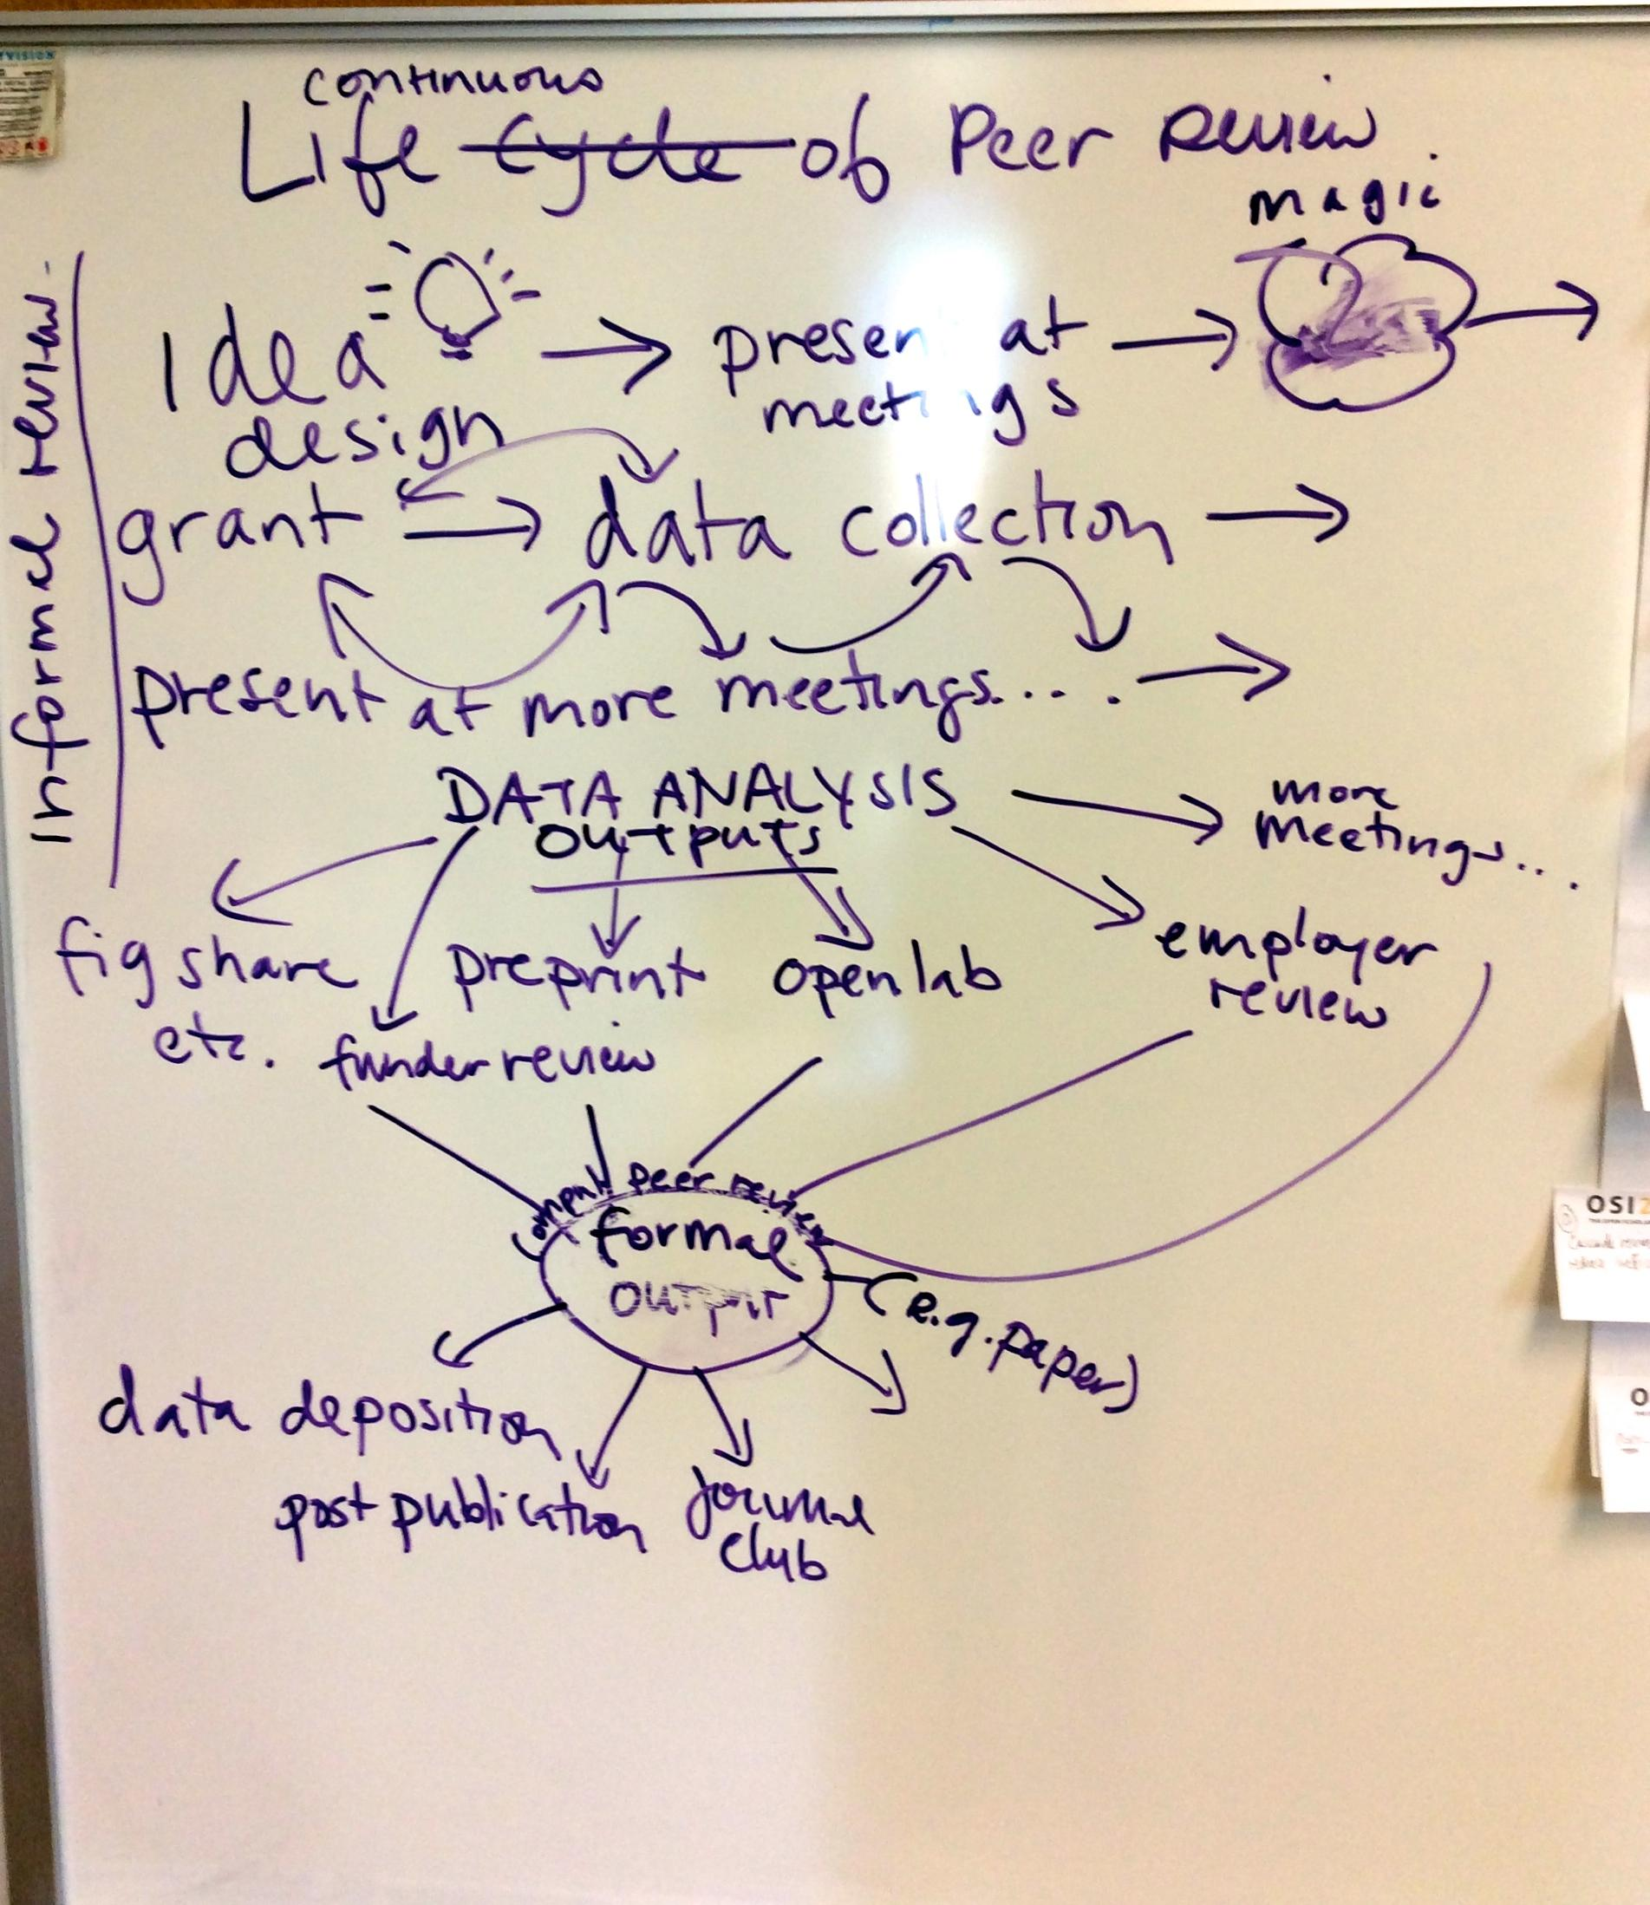
It’s not just the gatekeeping of the scholarly process.

Slide 7
Recommendations: “pre-publication”
Encourage all stakeholders to use preprint servers so that work is available sooner to enable a wider review.
Develop a more flexible, nonlinear process of peer review that facilitates many kinds of scholarly engagement and collaboration.
Caveat: The type of review will depend on the output, its timing, and the stage at which it ought to be reviewed.
Benefit: Establishing priority and increasing the speed at which information is disseminated, encouraging collaboration.

Slide 8
Recommendations - “traditional” process
Work toward culture of open-ness. We need to hear from authors and the complete spectrum of stakeholders to do this.
Explore problems, real and perceived, with transparency in peer review.
Consider decoupling publication of reviews and disclosure of reviewer names.
Are there areas where openness would not be appropriate, e.g. for ethical reasons?
Notes:
Transitional phase required for culture change - numerous options until things more settled. Provide options for reviewers to be more honest. Evalutea weakensses. Stakeholeders need input

Slide 9
Recommendations: post-“publication”
May work best if it’s a FORMAL part of the process (vs. informal commentary)
Version 1: F1000 model: swift technical check followed by full peer review after publication (pubmed after 2 peer reviewers)
Version 2: Post-publication review of traditional publications (e.g. incentivized crowd system that prevents trolling)
Post-publication review may help with fraud detection and improving the literature, but also raises issues about versioning, citations etc.

Slide 10
Have we addressed weaknesses?
Bias
Doesn’t protect from fraud
Delays publication
Conflicts of interest
No incentive (e.g credit)

Slide 11
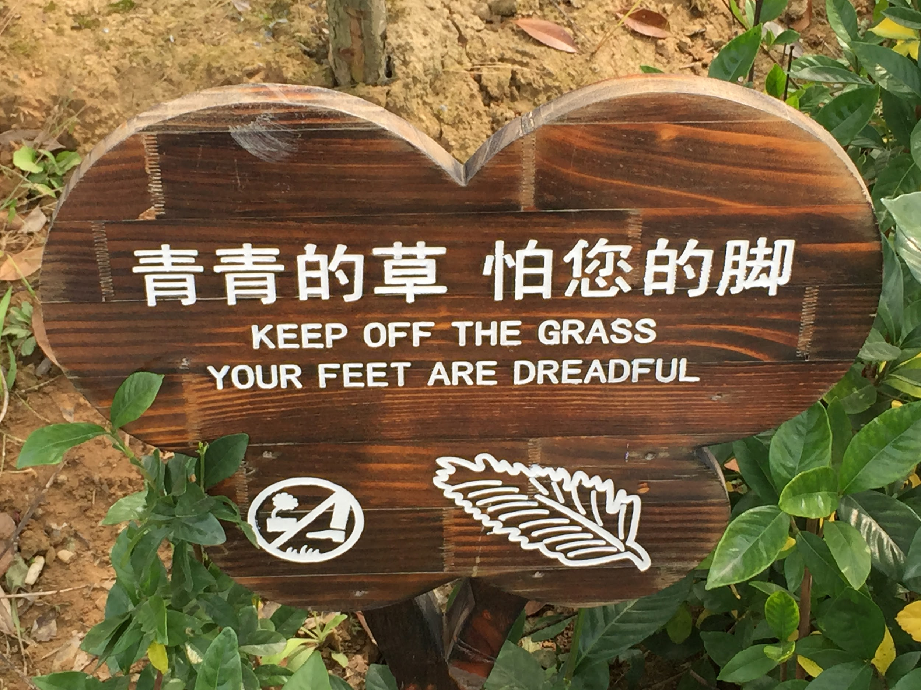
Gatekeeping...

Slide 12
Issues….
Wait--should we hear from the authors? Open = info overload? Validation of review? Are we technologically ready for flooding preprint servers? Will this kill journals? Or what will the role of the journals be? Societies vs publishers? What is the sweet spot in the timeline for the open review? Is it field-dependent? Cost….is shifted rather than reduced. Versioning costs? Can we kill the version of record? So things can be updated and re-reviewed. We need to see what is lost by these changes.

Slide 13
SWOT - Strengths Weaknesses
Relies on trust/goodwill Trusted by researchers Peer review adds value Provides some level of validation by experts Mostly trusted by most research communities Imperfect, but the best system we have to date It does work within its limits Voluntary/free Encourages care and rigor Filters for a target audience Expert scrutiny Often leads to improvements or discovers flaws Adds credibility to published works Can sometimes spot flaws Improves papers when it works properly Improves science and stimulates thinking Sets criteria for acceptance, thereby motivating authors to improve quality (Ware, p 5) Favors discussion and feedback Tried and tested Careful reading is a benefit
Lack of openness hides bias
Bias: gender, affiliation, country, discipline
Bias and empowering of certain views and/or paradigms
Not transparent – biases go uncovered
Current system allows bias to interfere with impartial analysis
Reviewer COIs, Editor COIs
Biases can interfere
Single-blind peer review allows reviewers to veil criticism behind anonymity (Ware, 6)
Not ‘blind’ enough
Unintentionally promotes conservatism (especially grants, but that’s a different conference perhaps…)
Doesn’t promote innovation
Negative/inconclusive papers not published
Dependent on trust- which is eroding
Relies on trust/goodwill
Perceived credibility
No credit for reviewing
Not designed to identify misconduct
Not designed to detect fraud
Doesn’t protect from fraud

Slide 14
SWOT - Weaknesses continued
The current system doesn’t do a great job of addressing research misconduct
Data in supplementary material often overlooked
Complex methods in multidisciplinary papers
Review of only one research object (article) at one time period
Some faculty / ??? feel that OA = pay to play and therefore unethical
Little training for peer reviewers
Increasingly difficult to find reviewers
Open access journals may not attract quality reviewers
Reviewers review for journals and editors, not for their peers
Element of chance- only 2 or 3 reviewers out of many potential opinions
No independent scrutiny and analysis
Too few eyes
The longest part of the publication process
Can be time-consuming, slow
Delays publication (Ware, p.6)
Takes too long
Time delays
Takes too long – important data withheld from public/researchers
Reviewers at some journals delay publication by imposing burdensome/non-critical demands on authors
Scooping
Unwieldy system for managing is cost- and resource-intensive
Peer review stops on publication
Doesn’t add value

Slide 15
SWOT - Opportunities Threats
Pre- or post-publication review could be a new model Fully transparent post-publication review for journals Fully transparent pre-publication review for books Becoming more public Open, post-publication peer review Credit/recognition for reviewers an essential part of scholarly ecosystem Cascade review can reduce inefficiency (Ware, p. 19) Automation/de-skilling of some elements--leave it to people to judge results Quality/science/impact Better tools for matching qualified reviewers to content In an online environment it is possible to make peer review more of an ongoing process Open review promotes transparency (Ware, p. 13) Portable peer review Remove shackles of print/mail and develop existing system for digital world
Peer review is an attention portal that adds value, so changing it could be threatening
It is unclear whether researchers will continue devoting time to peer review if they are not incentivised to do so
If not done by the journal where does that leave the journal? Does it matter?
“Managing peer review” becomes commercial product
People thinking it’s fixed
Novel ideas and emerging subjects disadvantaged
Throw everything online and hope for the best leads to lots of shoddy information
Flawed research still gets published, e.g. STAP, Benveniste etc
Closing the scientific mind
Gaming/fraud/cheaing
Bias
Corruption
Time (waste of extensive amount of time finding reviewers)

