Slide 1
Participation
Sudharshini Subramaniam, http://goo.gl/KdorYk,
by permission.
InCENTIVES FOR ACCELERATING CHANGE
Notes:
Our charge was to address participation in a world characterized by open scholarship

Slide 2
Premise/Objective
Authors are the original content creators
Authors select publication venue
Subject to a range of influences
Funders
P+T committees
Prestige among peers
Authors are increasingly seeing the value of OPEN
Dr. Seuss, The Lorax
Notes:
We interpreted the charge as a focus on “authors first”.

Slide 3
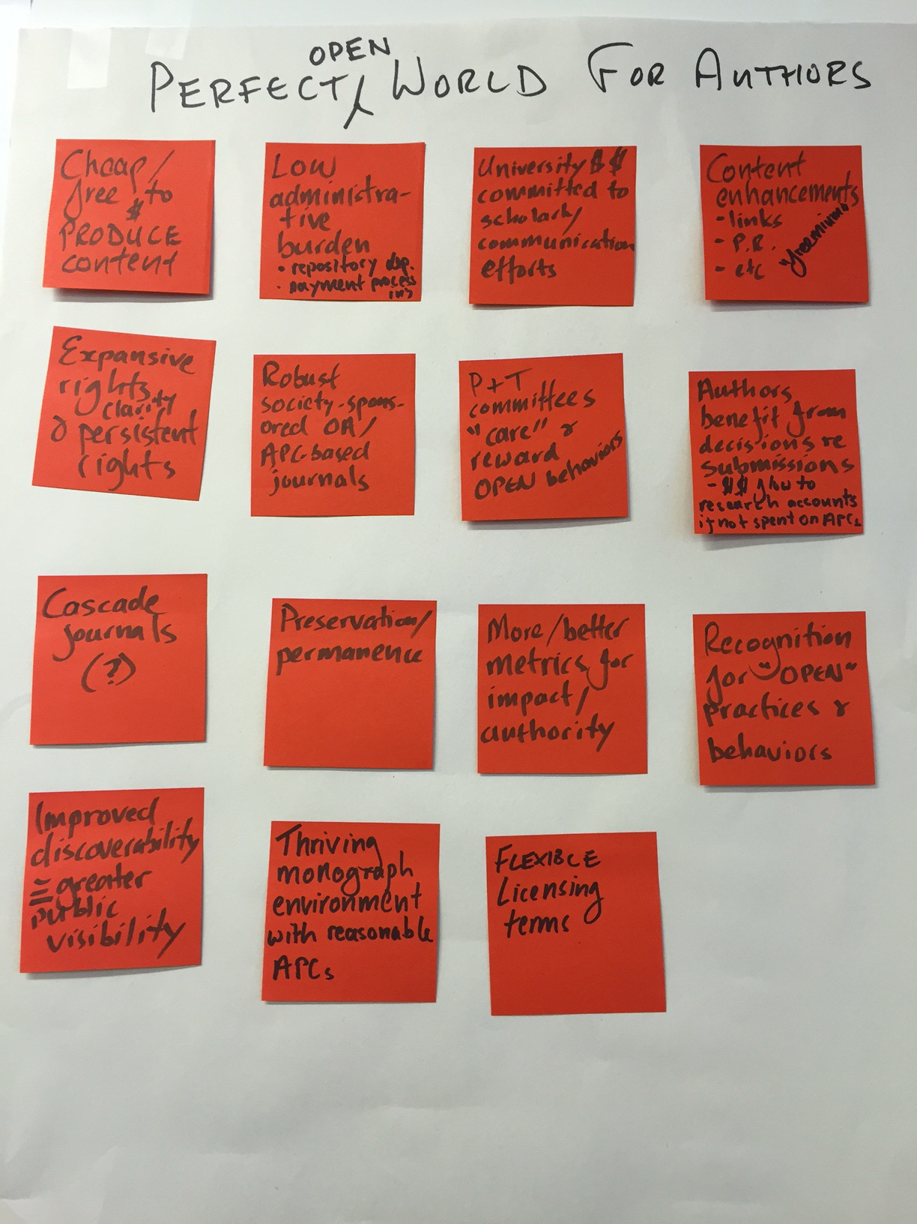
An author’s perfect world
Nancy Davenport, American University. By permission.
Notes:
To guide our assessment of challenges and develop proposals, we envisioned an author’s perfect open scholarship world
- Authors have clear, expansive, and persistent rights
- Flexible licensing terms
- Cheap/free to publish content
- Thriving monograph environment
- Low administrative burden
More/better metrics for assessing scholarly impact
If this were the world, authors would participate. How can we help it to occur?

Slide 4
Inhibitors and Challenges
Apathy Active opposition
Perception that everyone who “needs” to read scholarship can read scholarship
Too busy to participate (particularly “green”)
Vested interest in status quo
Funding support (publishing fees) — remaining inclusive
Inconsistent author rights environment
Fears about being scooped/IP/plagiarism, etc.
Unfulfilled publisher obligations (access inhibitors)
Notes:
We identified a number of inhibitors to author participation
Reducing these motivates the proposals we will offer

Slide 5
Proposals
Unified messaging involving and informing
Author community
Institutions
Funders
Publishers/peer communities
More high value OPEN communication vehicles
Clear, expansive, and persistent author rights
Author-focused impact metrics
Valuable content enhancements
Content promotion
Notes:
Now…our proposals. In short, change behavior - increase participation by increasing benefits to authors, or decreasing costs
First, given misconceptions, confusion, fears and varied perceptions - we should address collective effort to produce more concise & consistent messaging
Second, we need to overcome apathy and resistance, we need more and better venues
editorial quality is the first consideration
but open venues can increase participation with more value added for authors

Slide 6
Proposals (cont.)
Institutions commit resources to OPEN scholarly communication efforts
Reward authors who publish in low-cost OPEN venues
Reduce administrative burdens on authors (Green and Gold)
Redirect funds toward supporting OPEN venues
Faculty governance bodies advance policies to support OPEN behaviors (e.g. P&T)
Community recognition of OPEN practices/behaviors
Notes:
Third, the greater social value from open scholarship justifies additional resource commitments by universities, funding agencies, etc.
For example, in universities some inducements that might increase author participation include
various financial and other rewards — esp for considering cost as well as quality
etc [FROM SLIDE]
these greater investments are likely to pay off in the future through lower overall costs of publishing
Universal recognition of the importance of influencing faculty governance bodies to support OPEN — esp P&T

Slide 7
Future Research
Pre/post tenure publishing behaviors
Impacts of OPEN
Innovation
Social advancement
Inclusivity
Citations, impact measures
Policy
Cooperative/collective funding models
Impact of open access monographs on sales of print monographs
Impact on these proposals on participation!
Notes:
To make further progress on increasing author participation, we would benefit from further understanding and data on a number of issues, eg

Slide 8
Team members
Barbara DeFelice, Dartmouth College
Crispin Taylor, American Society of Plant Biologists
Gary Evoniuk, GlaxsoSmithKline
Jeff MacKie-Mason, UC Berkeley
Jane McAuliffe, Library of Congress
Jennifer Pesanelli, Federation of American Societies for Experimental Biology
Julie Hanford, University of Toronto
Michael Wolfe, Authors Alliance
Nancy Davenport, American University
Paul Royster, University of Nebraska, Lincoln
Pollyanna Frantz, American Association of State Colleges and Universities
Scott Montgomery, University of Washington

