Slide 1
Karina Ansolabehere
Cheryl E. Ball
Medha Devare
Tee Guidotti
Ryan Merkley
Bill Priedhorsky
Mike Taylor
Wim van der Stelt
Susan Veldsman
John Willinsky
v2.0
Image reproduced under Fair Use doctrine:
(A) Parody and (B) Transformative use

Slide 2
Notes:
We released our inner krakens on the issue of morality in making scholarship open. (dissent)

Slide 3
Stakeholders
Authors Readers Publishers Funders Institutions Disciplines Society
Image from richardjohnsonillustration.co.uk
Notes:
Stakeholders: Who has moral obligations to enact open access? ALL. Not just top down, but bottom up from faculty/disciplines and users.
(no more movies)

Slide 4
Foundations
Research is a public good.
Openness is globally fair.
Notes:
Improving the human condition > open *scholarly* research to all
The group: We are morally compelled to advance open access for scholarly publications and data
Everyone on the planet needs access to scholarly research. Moving us toward global openness benefits all sides of discourse and all economies.

Slide 5
Why?
Research saves lives and improves quality of life.
Notes:
Why is research a public good?
Research saves lives. If we embargo it for too long, we act immorally.
This is not just true of science but of social sciences and the humanities. #allresearchmatters (race rhetoric to cancer)

Slide 6
Respectful Means
Respect (fully disagree with) IP law
Respect privacy & varying discourses
Be thoughtful to avoid unintended consequences
Use all available (digital) means
Notes:
By what means can we reach that high moral ground with open scholarship?
[* quite contested] With IP law, work to advance its contribution to the public good by changing it for the better. (e.g., SciHub)
For Privacy, we must attend to both individual and societal privacy protocols, such as those of indigenous populations
We must remember that not every stakeholder within a community represents the group, and we must treat each other kindly and apologize when we fuck up.
“All available means” → With digital technology, we can enact this good by “creating additional value out of thin air.” (Mike)
→ Contested: Pushes all stakeholders (in group) to recognise the urgency of change.

Slide 7
Transparency of...
Cost effectiveness
Economic models
Research methods
Editorial processes
Global fairness
http://tinyurl.com/osi-morals
Notes:
Two moral dimensions of OA publishing, the first is transparency. → Evaluating how transparent each of these issues are (e.g., Openness Score) will help stakeholders of all types determine how well their research processes and products are meeting this moral obligation to create public good. Some questions:
How much of a researcher’s budget is going to APCs?
How do the economic models of journals have global impacts (e.g., ArticlePCs, subscription, libre).
How open are our methods and data so that we can validate results and not duplicate studies within and across disciplines? Linus’s law for software: “with enough eyeballs, all bugs are shallow.”
How rigorous and open is our peer review?
How internationally open, welcoming, and available are our publications REALLY?!
→ Our draft report is still online for commenting

Slide 8
Accessibility
Be FAIR
Findable Accessible Interoperable Reusable
and budget for fairness.
Notes:
Research stakeholders have a moral and ethical obligation to budget appropriately to make data and publications Findable, Accessible, Interoperable, and Reusable (FAIR). We want to highlight the BUDGET part, as it comes at the beginning of a research project, when stakeholders must budget (time and money) for data management and the open and universally accessible use of research publications.
Related to this, I would like to invoke the relationship between open access, accessibility for users of all needs, and preservation. In many countries, being FAIR is required by law, nor just a morally held belief. This means that users, too, whether they are scholars, journalists, or our hypochondriac great aunt Sarah, also have a moral and ethical obligation to cite published research in whatever manner is appropriate.

Slide 9
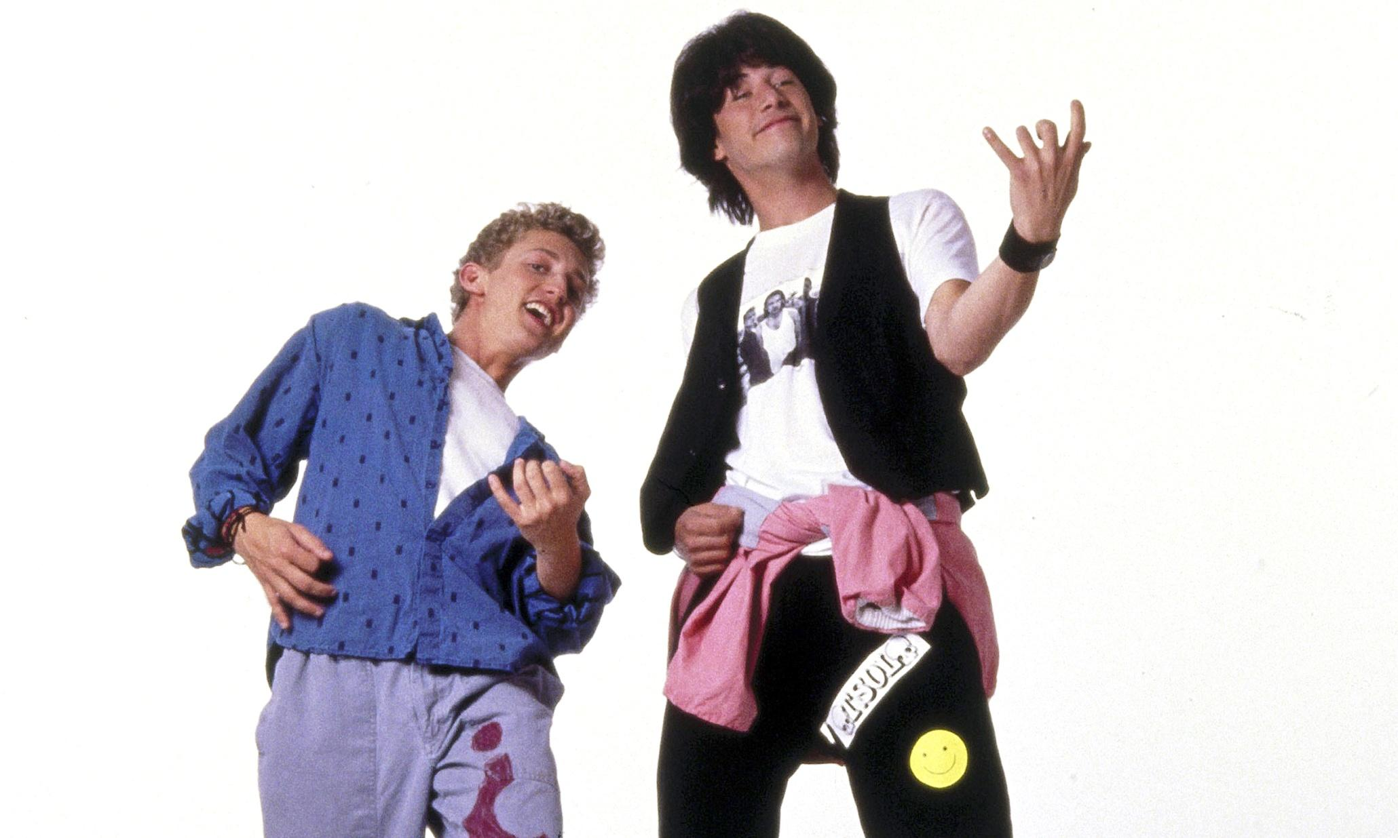
Moral Action
Be Transparent
Be Accessible
Be Excellent to Each Other
Notes:
In sum, the action items proposed by the moral dimensions group are less based in deliverables and more in human kindness. It is ALL our responsibility. Thank you.

