Slide 1
Embargoes
A period of time during which there is restricted access to content
OSI 2016

Slide 2
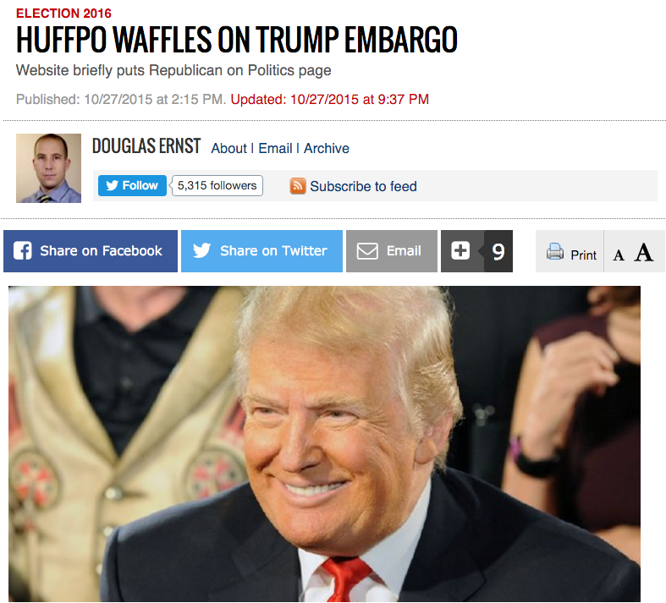

Slide 3
Definitions
Pre-Publication Embargoes
Press embargoes – journalists like having embargoed access
Post-Publication Embargoes
Access restrictions to Accepted Manuscripts
Subscription Embargo
Access restrictions to Version of Record
No-Publication Embargoes
Deposited content from Government studies (security), proprietary research, patents - may or may not ever be publicly released

Slide 4
What is being embargoed?
Journal articles
Data
Press releases
Proprietary research
Security-related research (Governments)
Other?

Slide 5
Impact of embargoes
Funders
Authors
Researchers, discipline communities
Institutions, librarians, repository managers
Publishers
Learned Societies
Policy makers
Journalists
Consumers (tax payers) – public (e.g. patients), small/medium enterprises, non-affiliated researchers, practitioners

Slide 6
Proposal - research project(s)
What are the impacts of embargoes on scholarly communication
Create evidence base for informed discussion on embargoes
Research in the next 12 months to inform OSI 2017

Slide 7
Research questions
Who needs access?
How are embargoes determined?
How do researchers/students find research articles?
Impact of embargoes on researchers/students?
Effect of embargoes on other stakeholders?
Need to consider
Geographical and disciplinary differences
Changing landscape - use of AMs 5 years +

Slide 8
Preliminary cost estimation
based on
64 working days
$800 per day (or intern/PhD?)
in the region of $50,000

Slide 10
Embargoes
A period of time during which there is restricted access to content
OSI 2016

Slide 11
Research questions
Who needs access?
How are embargoes determined?
How do researchers/students find research articles?
Impact of embargoes on researchers/students?
Effect of embargoes on other stakeholders?
Need to consider
Geographical and disciplinary differences
Changing landscape - use of AMs 5 years +

Slide 12
Tasks and timeframes
Task | Time frames | Estimated costed time
1. Writing of the brief | Due two weeks from the end of the conference - 6 May 2016
2. Sourcing funding | Needs to be secured by August 2016
3. Literature review | 2 months - begin August 2016 | 10 working days
4. Live case studies [Concurrent to Literature review] | Due to be completed October 2016 | 11 working days
5. Survey of the different stakeholders | 6 months total - Needs to start by October 2016 at the latest
5.1 Creating the survey | 3 months. October - December 2016 | 24 working days
5.2 Identify & engage participants | 1 month. January 2017 | 6 working days
5.3 Analysis of results | 2 months. February - March 2017 | 13 working days

Slide 13
Writing the brief/source funding
Project brief forms report to OSI 2 weeks after the conference
Funding offers actively sought (responsibility and management)
independent organisations
research funders
library organisations
publishers
Risk that single funding might imply bias. Instead propose a ‘crowdfunding’ model of 12 funders of $5,000 each
$10K incl. for O/H and admin
$50K for research

Slide 14
RFI / Identify researcher(s)
Obtain estimate from potential researchers/groups
Criteria for researchers:
Independence
track record
global reach
acceptance by all stakeholder groups

Slide 15
Literature review / case studies
identify and gather existing data and other relevant projects
identify and examine the evidence from case studies (e.g. SAGE, T&F LIS embargo trials)

Slide 16
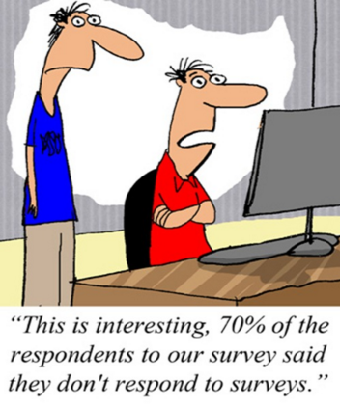
Survey stakeholders
analyse data gathered
identify stakeholder groups
craft questions
pilot questions (steering group?)
design and create survey

Slide 17
Engage participants / collect results
identify representative groups to extend survey reach to relevant stakeholder groups
distribute survey
manage collection of results

Slide 18
Analyse and report
data analysis
draft report for OSI 2017
easy to interpret summary
data in figshare
potential for peer reviewed OA article(s) - No embargo!
blogs, The Conversation, Research Information, Inside Higher Ed, Scholarly Kitchen, Against the Grain
cross-stakeholder webinar

Slide 19
Future work (post OSI2017)
Consider standards work that can come from the findings relating to embargo setting:
NICE
NISO
CASRAI
Others?

