Slide 1
Themes & Observations
At Large Group
April 22, 2016
OSI 2016 George Mason University
Notes:
Library as Publisher: New Publishing Ecosystems
Presented by: John W. Warren- Head, Mason Publishing Group/George Mason University Press, George Mason University Libraries
Many academic libraries are moving into the publishing landscape, and an increasing number of university presses are now part of their university library infrastructure. The business of libraries and publishers are now intertwined and overlapping. Libraries have been proponents of open access, whereas many scholarly publishers have been wary about, if not hesitant to implement, open models. How are priorities such as funding and sustainability achieved? The Mason Publishing Group, an initiative within the George Mason University Library, provides support and resources to the George Mason University community for creating, curating, and disseminating scholarly, creative, and educational works. Programs and services of the Mason Publishing Group include the George Mason University Press, scholarly communication and copyright, University dissertation and thesis services, the Mason institutional repository (MARS), electronic journal hosting and publishing, and data publication. Planned services include publication of e-books and conference proceedings. This session provides an overview of the current library publishing landscape and efforts at Mason to create and sustain this initiative.

Slide 2
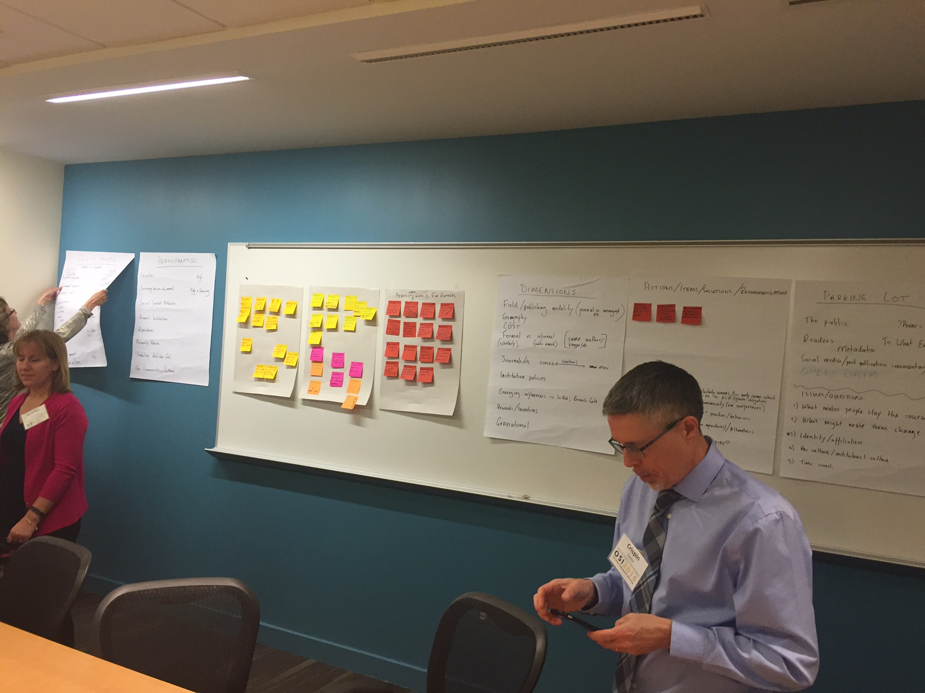
Collectively we noted some themes and observations during OSI2016

Slide 3
Observations on the OSI Process

Slide 4
Changing Scholarly Outputs and Changing Needs

Slide 5
The Primacy of Promotion and Tenure

Slide 6
Stakeholders and Missing Voices

Slide 7
The Influence of Impact

Slide 8
Notes on Moving Forward
Notes:
People came committed to this and they participated and they worked!
But perhaps some worthy delegates (i.e. Provosts, Senior Researchers) did not come because of the time commitment
Need for Collective Action
Bring crowd share together
Collaborate / share info across groups
Tell a single story
Need for a better way of communication/idea-sharing between different sectors of ecosystem
Telling/selling the story
Examples of OA told collectively to specific audiences
Most delegates/teams came with assumption OA is the best goal for future
Some discussed this but perhaps didn't question the assumption enough
Open is more complicated!
(Green OA is not the way forward)
We need better, clearer outreach
Foci of the next OSI
Develop more info to be presented at OSI 2017
Does every topic require another study before the next OSI meeting?
Desire to move the discussion forward
Develop standards?
Deliver tangibles or progress on goals
Confusion about the ultimate goal of this meeting was expressed by many delegates
What do we hope to achieve over the span of 10 years and how do we get there?

